Slide 1

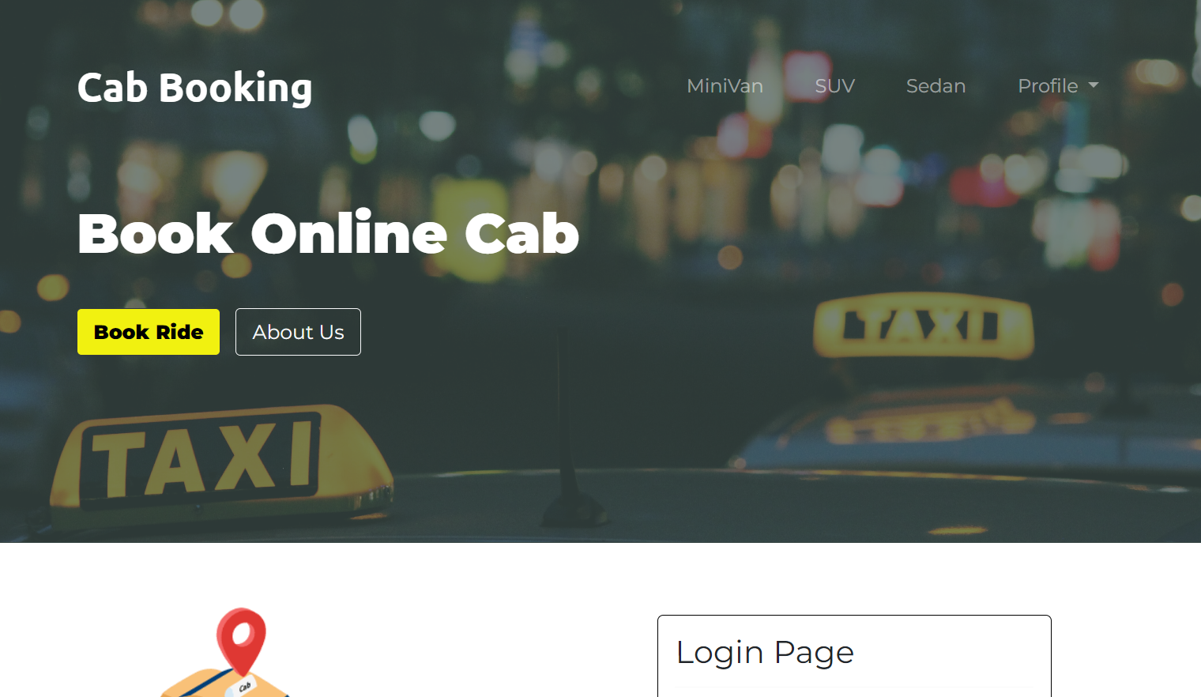
Cab booking Application
Contributors :
Anirudh
C. Ganesh
Satabdi Ray
Kedar Sai
Deeksha

Slide 2
Introduction
Problem Statement
Technologies Used
Modules
Class/Repository Design
App Workflow

Slide 3
Cab Booking System (CBS)
The cab Booking system is a cab booking service where customers can book a ride from a place in the city to another place in the city.
The cab Booking system offers mobility solutions by connecting customers to a wide range of cabs enabling convenience and transparency.
It was made to offer a comprehensive range of travel-related services for both customer and the admin. It provides the customers with various tools and information that they need to research, plan and book a cab in their city. It provides the admin with tools and services to manage the customers, drivers, and trips made. We offer this service online through our website.

Slide 4
Problem Statement
To Create an Application for Online Cab Booking
Customer should be able to view the list of available cabs.
Customer should be able to book cab for desired location from a certain location.
Admin should be able to perform below operations:
1. Cab Management
2. Driver Management
3. Booking Management

Slide 5
Sprints
Application developed in following sprints :
1.Core Java +JPA with Hibernate
2.Spring Boot + Rest Controller + JPA with Hibernate
3.Angular for UI design (Front End) + Integration with previous Sprint

Slide 6
Technologies Used
Spring Boot​
JDK - 1.8 or later​
Spring Framework​
Spring Data JPA (Hibernate)​
Maven​
IDE - Eclipse or Spring Tool Suite (STS)​
bootstrap​
PostgreSQL​
Angular​
IDE- Visual Studio Code​

Slide 7
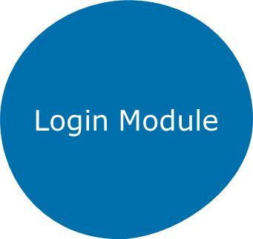
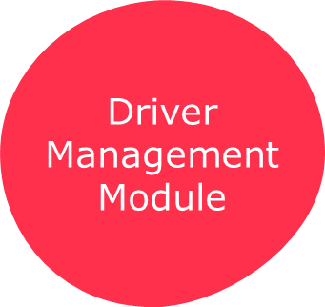

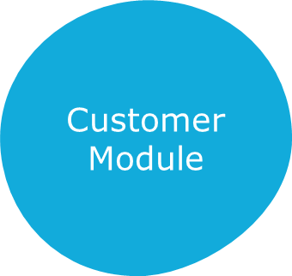
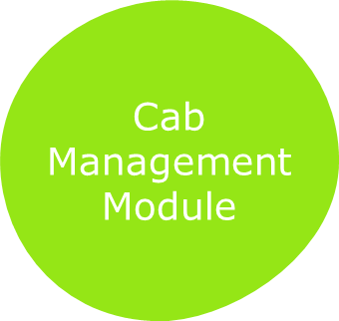
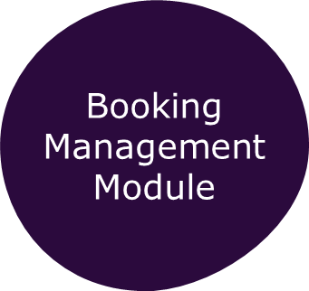
Modules
Vestibulum congue

Slide 8
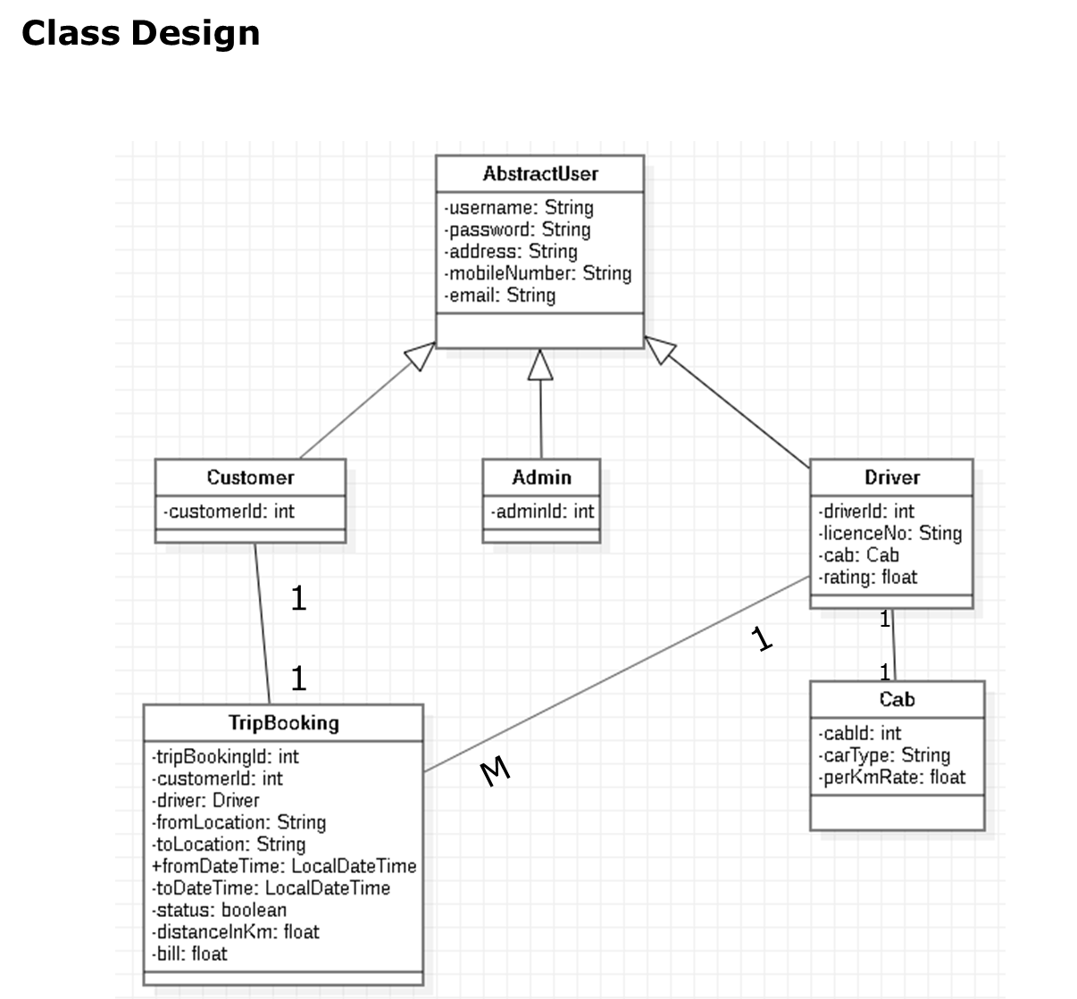
Class Design

Slide 9
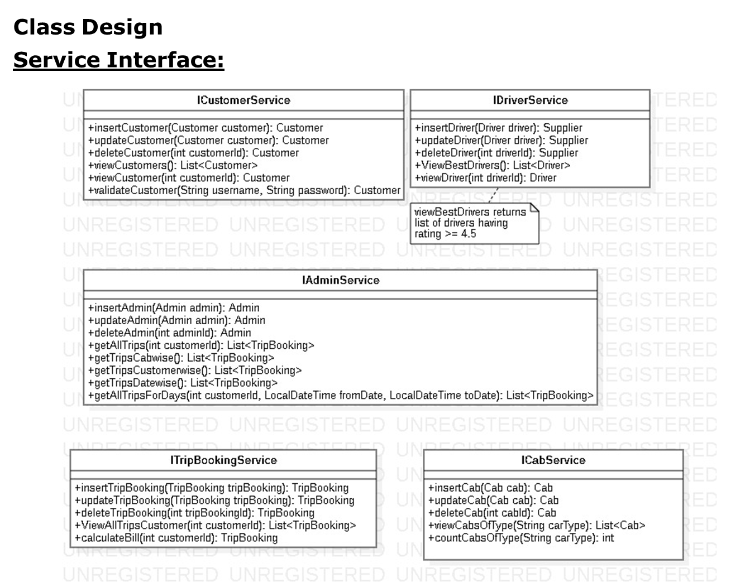

Slide 10
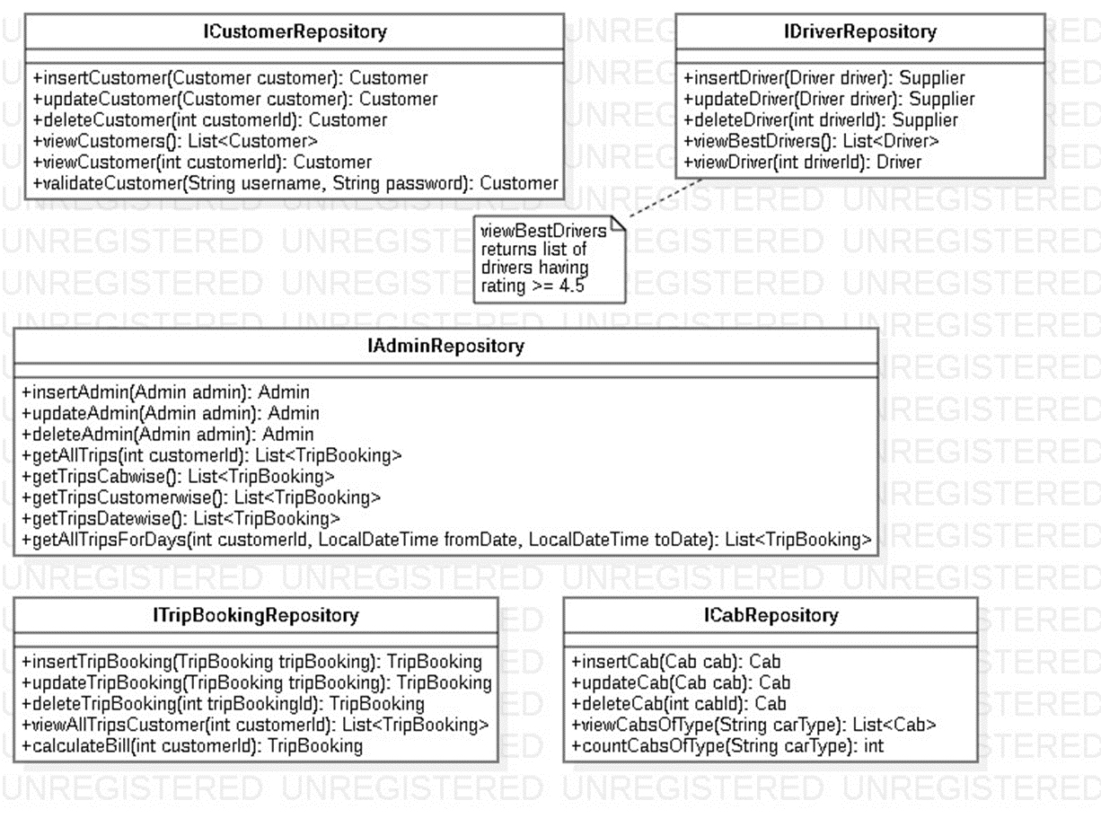
Repository Design

Slide 11
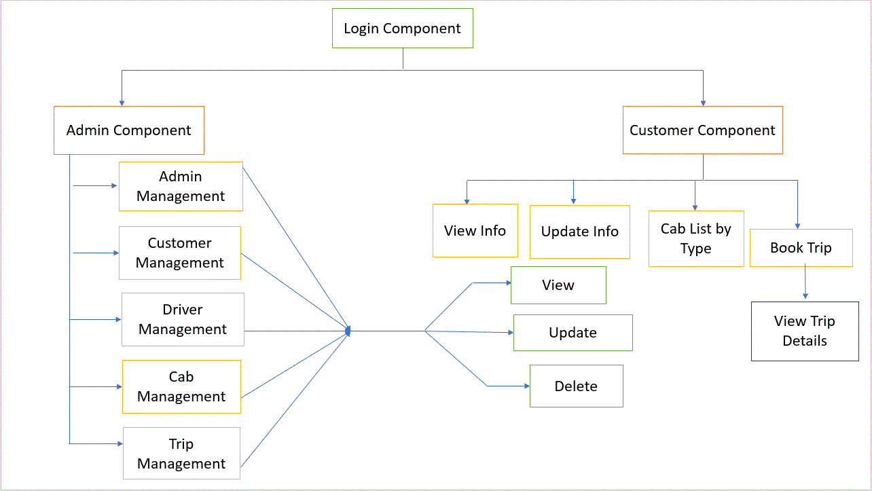

Slide 12
Questions?

